Slide 1

MED PLUS HEALTHY HEART CARE

Slide 2
INTRODUCTION
Heart is the most important organ of our body and its really important to take care of our heart. So we have made a heart disease predictor that allows the doctor to analyse and predict whether a person is prone to heart problems like heart attack etc. It comes with a chatbot for interaction as well as a doctor-patient chat interface to connect with the doctor.
Most of the people don’t get to know whether their heart is prone to disease or not so this project will them in analysing it and then connecting to a doctor for treatment.

Slide 3
TECHNOLOGY USED
We have used different programming lanuages for making this project:
1)Django
2)React.js
3)POSTGRESQL
4)TENSORFLOW, SCIKIT-LEARN,KERAS,THEANO,RASA,RASA NLU
5)NODE.JS

Slide 4
FUNCTION
Our project a lot of functions :
1)There is a login page where you put your details for logging in
2) Then the user has to enter all his details and based on his details it will be predicted whether his heart is healthy or not
3)If it is not healthy then it will show the diseases that the user might get and it would make you connect to a well qualified doctor which would help you in your treatment.
4) A health care Chatbot to diagnose diseases and reduce workload of doctors
5) A chat feature so that doctors and patient can communicate.
6) A Disease Predictor which can predict based on given symptoms.

Slide 5
BUISNESS PLAN
Each of the doctor would be a well qualified doctor who would be currently working in top-notch hospitals.
From each patient we would charge a very minimal consulting fees of Rs. 200-300 just for the smooth operation of our project.
From this consulting fees well keep only 10 percent and the rest would go to the doctor.
We have kept the consulting fees to be very less so that it can be accessed by all sections of the society.

Slide 6
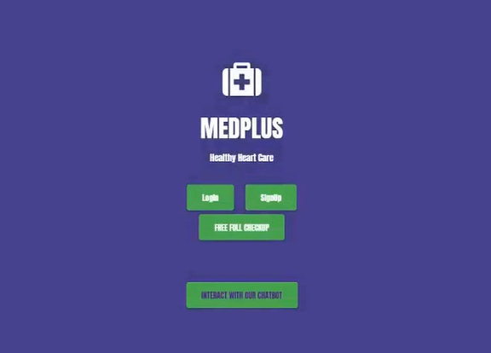

Slide 7
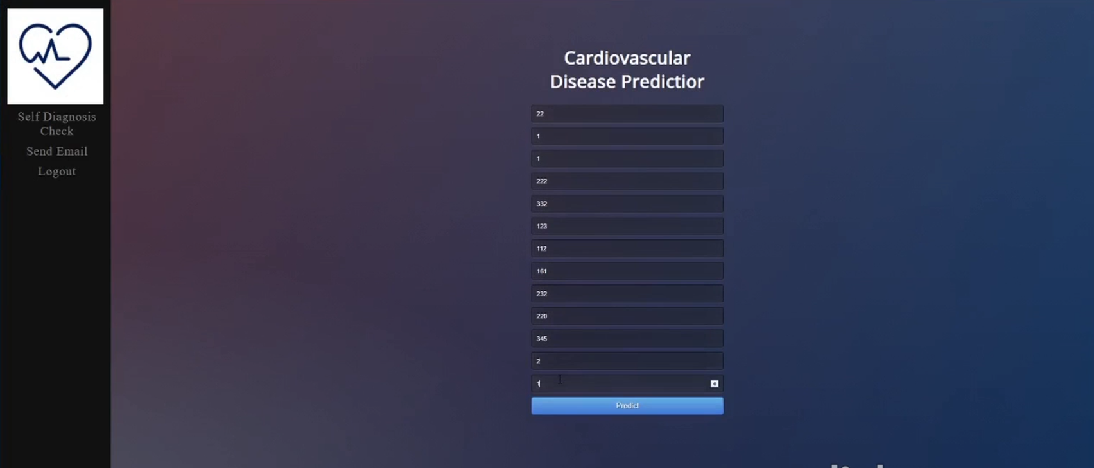

Slide 8


Slide 9
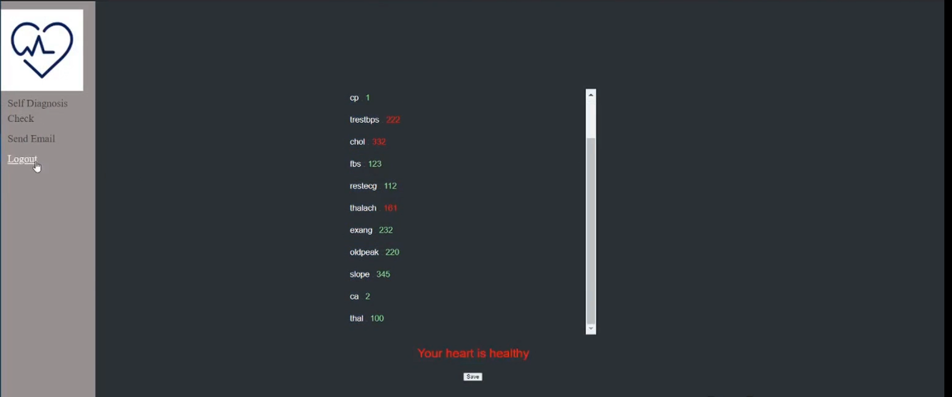

Slide 10
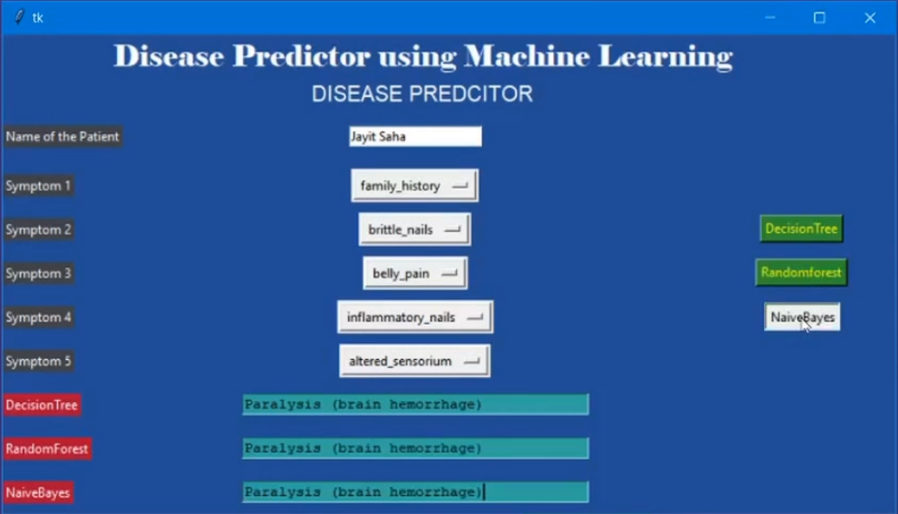

Slide 11
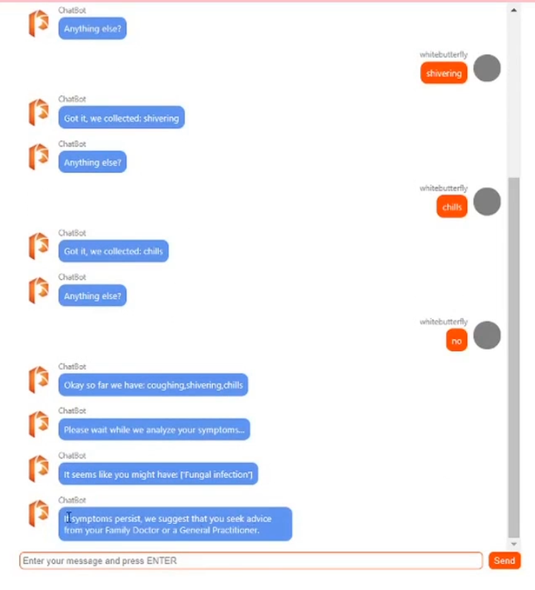

Slide 12
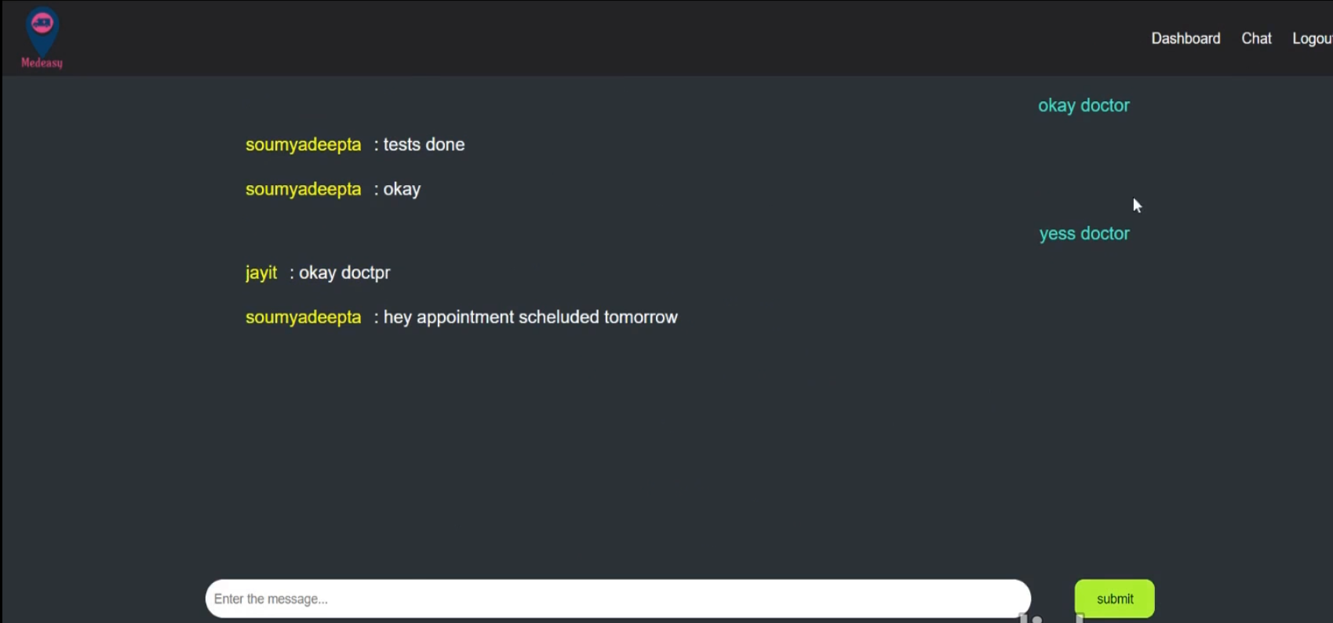

Slide 13
TEAM DETAILS
TEAM NAME : PARALLEL HACKERS
TEAM MEMEBERS :
DIVVYAM R AGARWAL
JAYIT SAHA
ANANYA SAJWAN
ISHITA DASGUPTA
SOUMYADEEPTA DAS

Slide 14
THANK YOU!!!

